Slide 1

Diabetes Analysis

Slide 2

Background Info
What's the difference between logistic and linear regression?
Linear Regression is continuous forming a line,, whereas Logistic Regression is binary, forming an S-curve.
What's the difference between predictors and response variables?
Predictors are features in a dataset that are used to explain the response variable of a dataset.
What is the purpose and benefits of preprocessing data?
The purpose to preprocessing is to clean up the data to get ready for analysis. This will lead to more accurate results.
What is the overfitting and underfitting that data? What are the consequences?
Overfitting is when you make your error margin too small, and underfitting is the opposite. The consequences of overfitting is that it has a lack of generalization on new data, and underfitting is a lack of capturing true patterns.

Slide 3

About the Data
Age: Binned decades (20-29,30-39,etc.)
Gender: Pretty obvious. Male or Female
Family_Diabetes: Is there a history of diabetes in the family?
highBP: Binary yes/no. They either have high blood pressure, or they don’t
PhysicallyActive: None, less than half an hour, more than half an hour, one hour or more
Smoking: Another binary yes/no
Alcohol: Same as smoking
Sleep: Average number of hours the patient sleeps each night
SoundSleep: Average number of sleep the patient gets that is considered to be REM sleep
RegularMedicine: Binary yes/no. Patient is either on medication or isn’t
JunkFood: How often does the patient eat junk food? Occasionally, often, very often, always
Stress: Is the patient stressed? Not al all, sometimes, very often, always
BPlevel: Your level of blood pressure. (Categorical)
Pregnancies: Number of pregnancies the person had. ( Numeric)
Pdiabetes: Whether a person got diabetes through pregnancy. (Yes, No)
UrinationFreq: How often the person urinates. (Categorical
Diabetic: Whetherthe person is diabetic. (Yes, No)

Slide 4

Questions
What are the features?
The features are the 17 columns listed in the previous slide, and 952 rows cleaned up to 950.
Which features are categorical and which are continuous?
The categorical features are age, gender, family diabetes, high BP, physically active, smoking, alcohol, regular medicine, junk food, stress, BP level, Pdiabetes, urination frequency, and diabetic.

Slide 5

Problem Statement
DIABETES!
Our goal is to create a classification model to analyze this dataset so we may predict if a person is likely to have diabetes or not.

Slide 6

Data Exploration
Started with non-NN models, Logistic Regression and Random forest.
Did unscaled, Robust, and Standard Scaling for all 3.
The calculated confusion matrix, classification report, and cross validation for standard scaler models.
Next was NN classification models.
Again we tried unscaled, Robust, and Standard scaling.
Standard scaling was picked for this as well.
Confusion matrix, classification reports, and cross validation reports were also written.

Slide 7
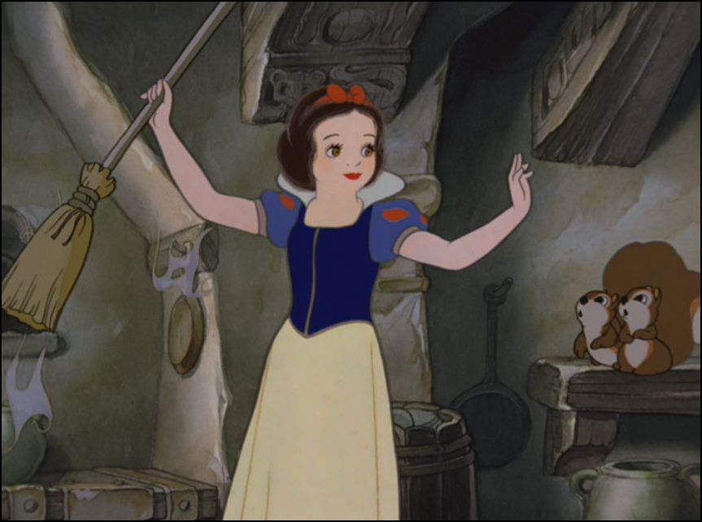
Data Cleaning
We instead used Label Encoding
We had some missing data, especially in BMI and Pregnancies.
Dealt with BMI by dropping, too many to average.
Dummy variables were not used.
Many unique values in each column.
We now have our “clean” data frame to work with.

Slide 8

Scaling
Scaling the data proved useful.
Dataset contained little to no outliers.
We tried no scaling, Robust, and Standard scaling in each model.

Slide 9
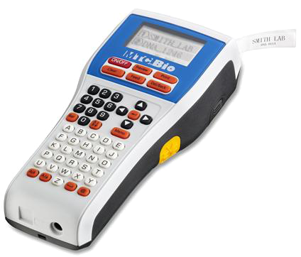
Preprocessing
Nothing needs to be modified with dummy variables
Label Encoding (the one we used) takes a series of related categorical variables and converts them to integers (Good, Bad, Poor becomes 0,1,2, etc.)
One-Hot Encoding adds a significant number of columns, since it takes each unique variable (Good, Bad, Poor) and creates a new column for each categorical value with either a 1 or a 0 depending on whether or not the row belongs to that category

Slide 10
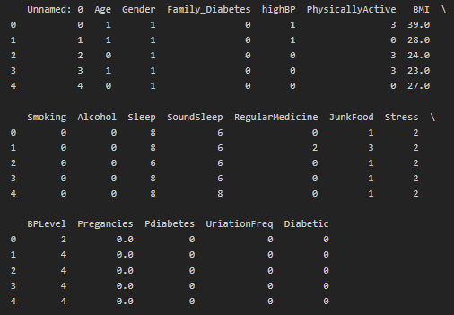
Here’s the updated data head

Slide 11
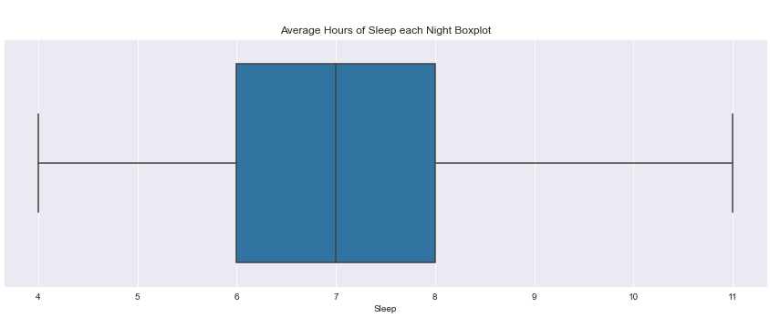
Plots
The average hours of sleep each patient said they got each night ranges from 4 hours to 11, with the majority of them landing within the 6-8 hour range

Slide 12
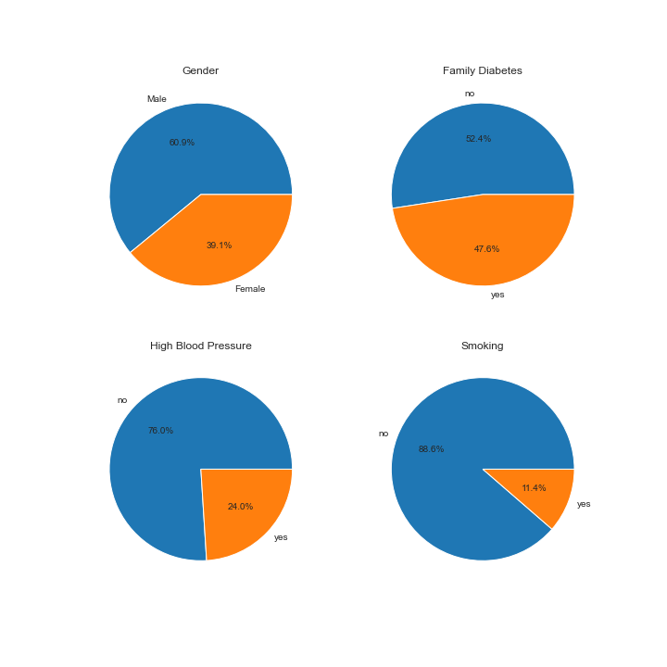
Pie Charts
Most of the patients surveyed were men, at almost 61%
Large majorities of patients reported not having high blood pressure and not smoking

Slide 13
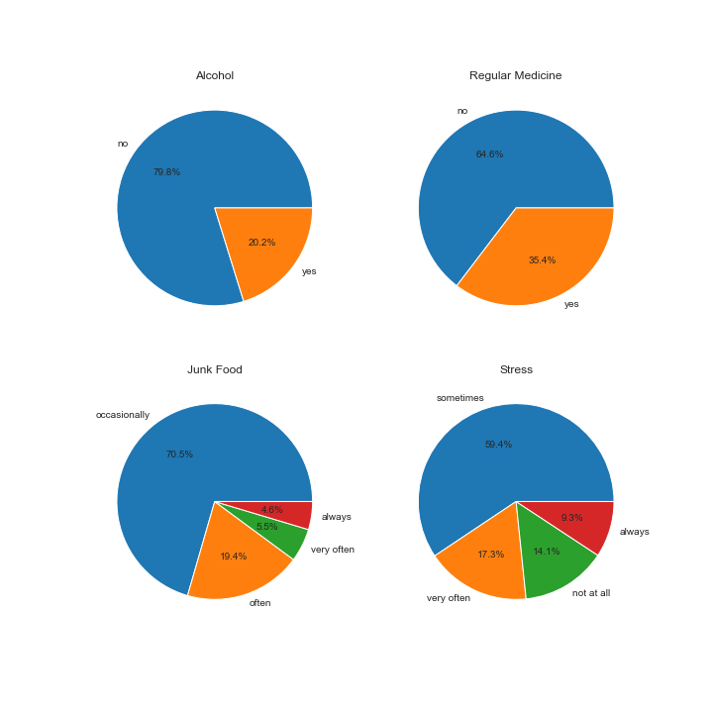
More Pie!
Over 64% of the patients reported not being on regular medication, drinking too much alcohol, and only occasionally eating junk food
59% of the patients reported feeling stressed, while 14% of exceptionally lucky patients reported not feeling stressed at all

Slide 14
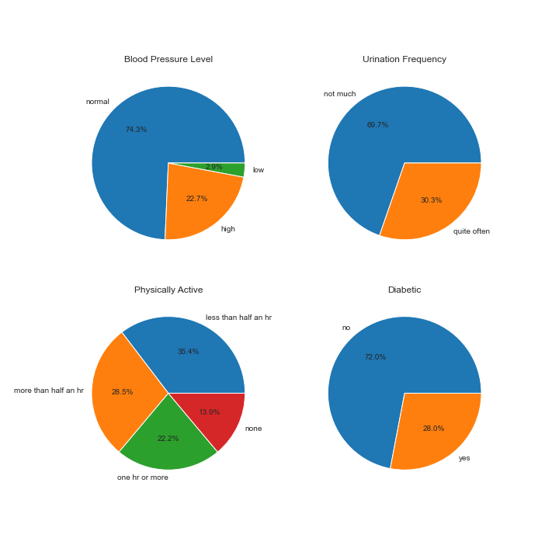
Even More Pie!
Most of the patients surveyed had normal blood pressure levels (74%)
There was a much larger spread amongst the physical activity than any of the other columns, with the highest being less than half an hour of physical activity a day at just over 35%

Slide 15
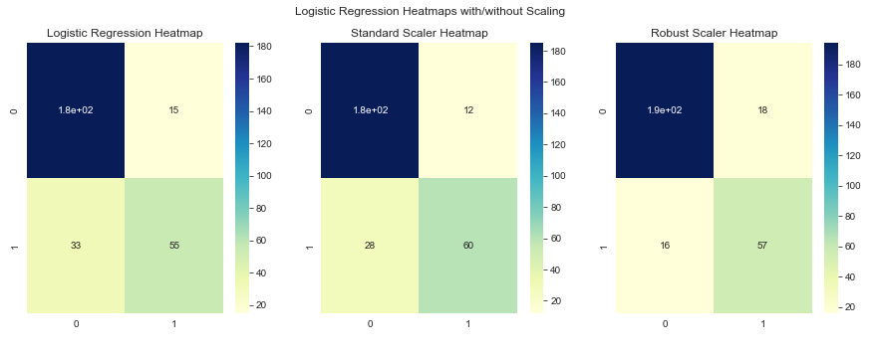
Non-NN Logistic Regression Heatmaps
Based on the heatmaps, the Robust Scaler Logistic Regression model was the most accurate model, only missing 34 cases.

Slide 16
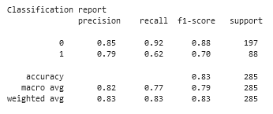
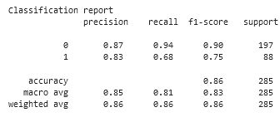
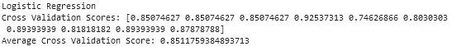
Classification report
Unscaled
Robust Scale
We can see that the accuracy and weighted avg. are superior in the robust scale.

Slide 17
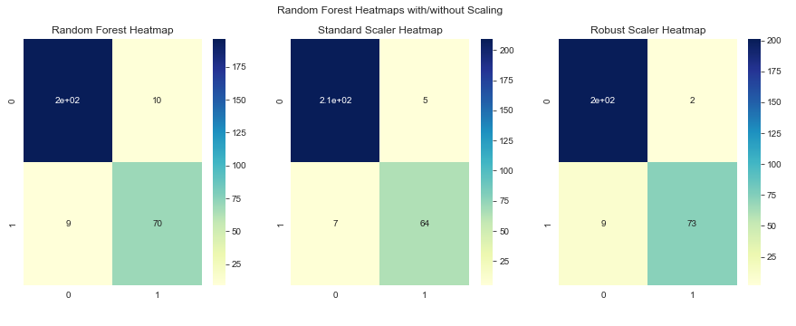
Non-NN Random Forest Heatmaps
Again, the Robust Scaled model is more accurate, even using Random Forest algorithms, only missing 11 cases.

Slide 18
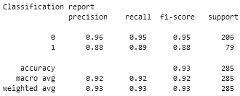
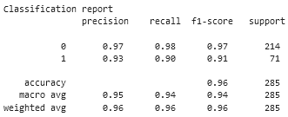
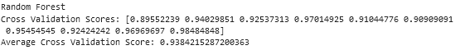
Classification report
Unscaled
Robust Scale
We can see that the accuracy and weighted avg. are superior in the robust scale.

Slide 19
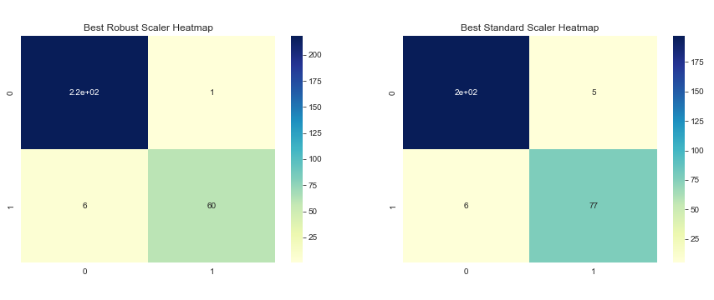
To Scale or not to Scale?
As the above image indicates, the best scaling option to use is the RobustScaler, since it correctly identifies all but 7 patient cases correctly.

Slide 20
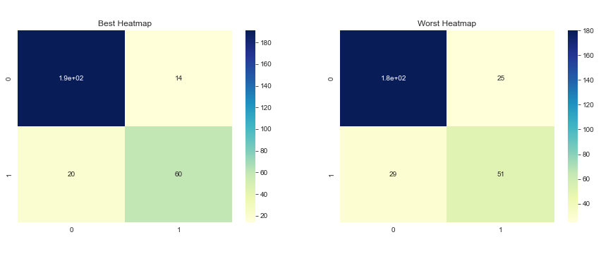
Logistic: Unscaled
The heatmaps show that the logistic regression model is fairly accurate when it comes to being able to accurately identify the correct result.

Slide 21
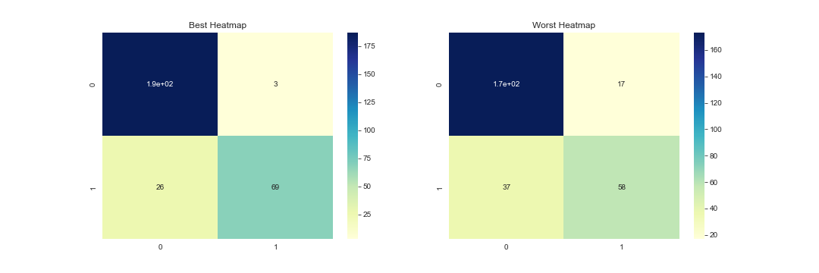
Logistic Regression Part 2: Electric Boogaloo
The scaled data produces a model that is worse at producing false negatives than the unscaled model, which is concerning.

Slide 22
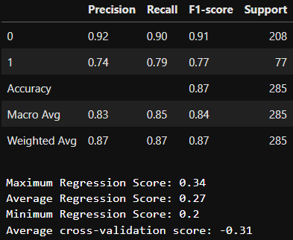
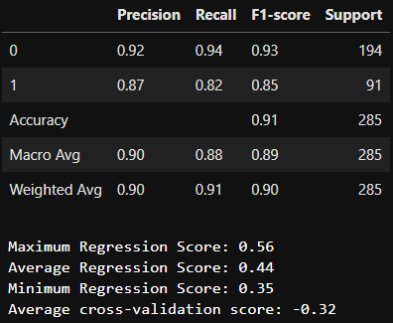
Logic Reports
Unscaled Classification Report Scaled Classification Report
As the above reports show, neither model works too well when looked at with respect to the r2 score. The cross validation score for both is negative, which is…not good.

Slide 23
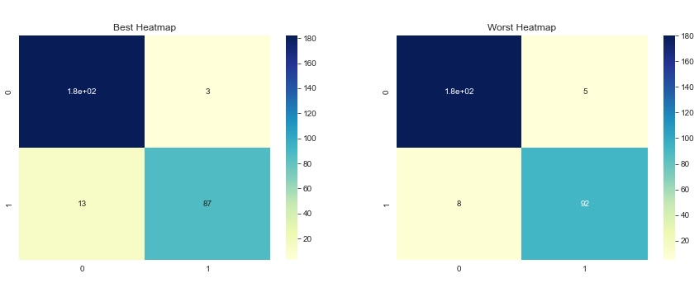
Classification is in Session
While the “Best Heatmap” Is technically less accurate, it has a better r2 score, which is what determined the “best” report.

Slide 24
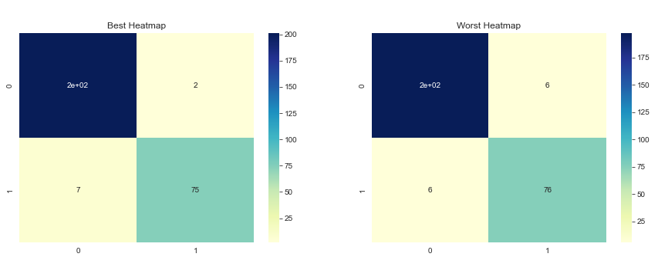
Scaling the Classifieds
As is evident, scaling the data makes the model more accurate when not scaling the data.

Slide 25
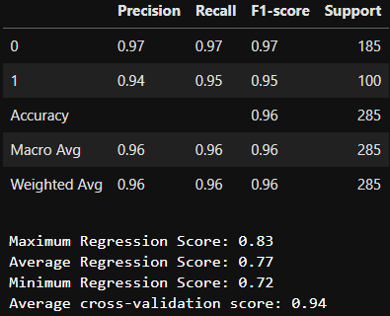
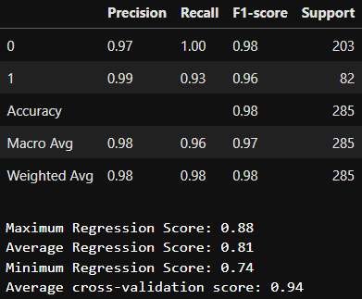
Classification Classification Reports
Unscaled Classification Report Scaled Classification Report
As is evident by the above classification reports, the average cross validations are infinitely better than the cross validation scores of the logistic regression classification reports.

Slide 26

Conclusion
Predicting diabetes is easy when you have enough data, the right model, and scale the data. Three simple ingredients and you’ve got a recipe for predicting whether or not a given patient has a life-altering disease.

